Slide 1

GRADE 4
UNIT 3
MY THINGS!
LESSON 5

Slide 2


Listen and point

Slide 3
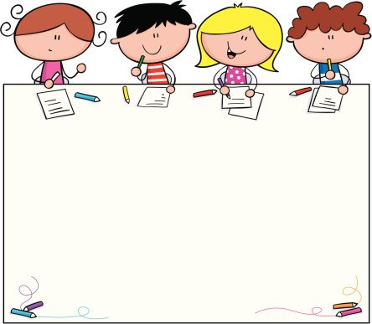



posters

Slide 4
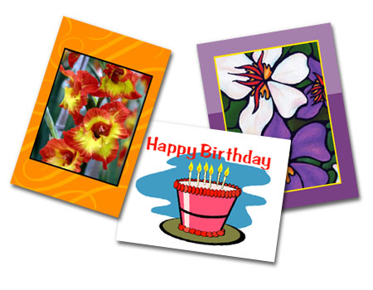
postcards

Slide 5
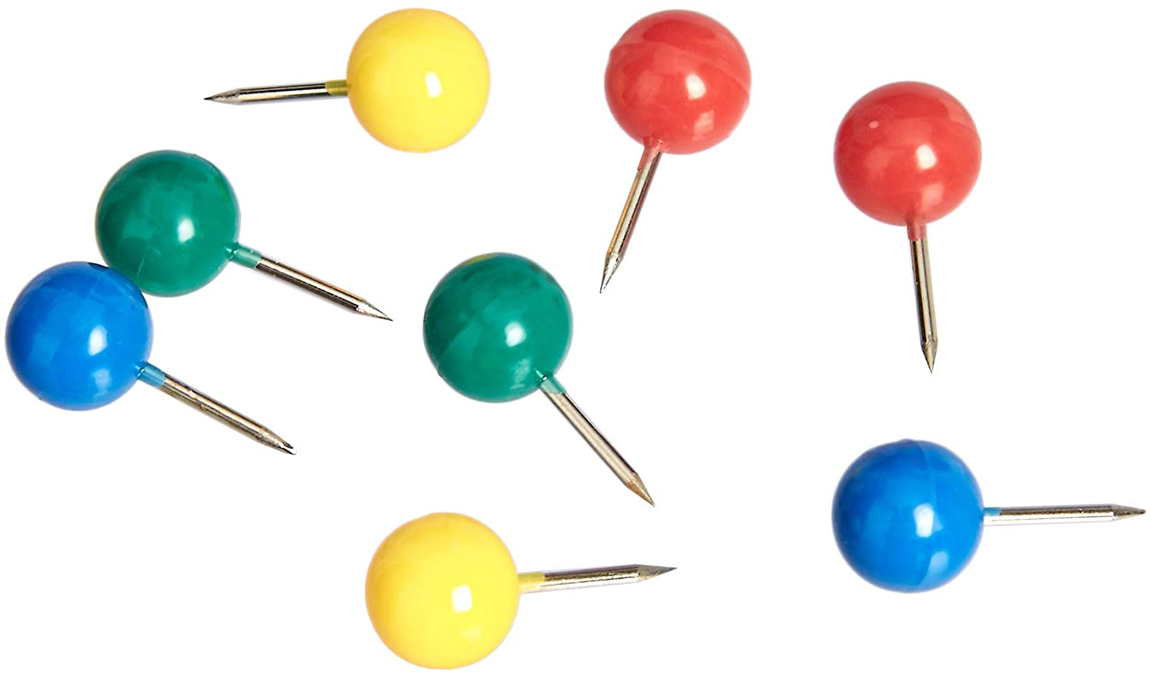
pins

Slide 6

shells

Slide 7
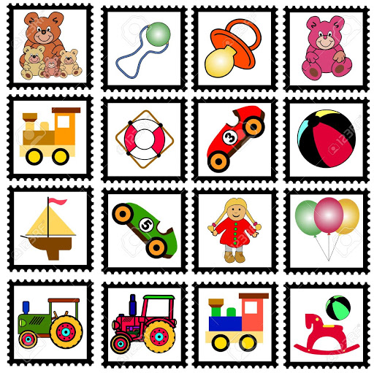
collection

Slide 8


